Slide 1

Data Analysis and prediction on Insurance Dataset
Presented by : Ankush Gupta

Slide 2

Introduction
Objective: To analyze the insurance dataset and build predictive models to estimate insurance charges
Agenda
Data Overview
Data Exploration
Data Cleaning
Feature Engineering
Model Building
Model Evaluation
Conclusions

Slide 3
Data Overview
Dataset Source
Description: Contains demographic information and insurance charges
Features
Age
Sex
BMI
Children
Smoker
Region
Charges

Slide 4

Data Exploration
Exploratory Data Analysis
Descriptive statistics of features
Distribution of target variable
Correlation matrix
Key Insights

Slide 5
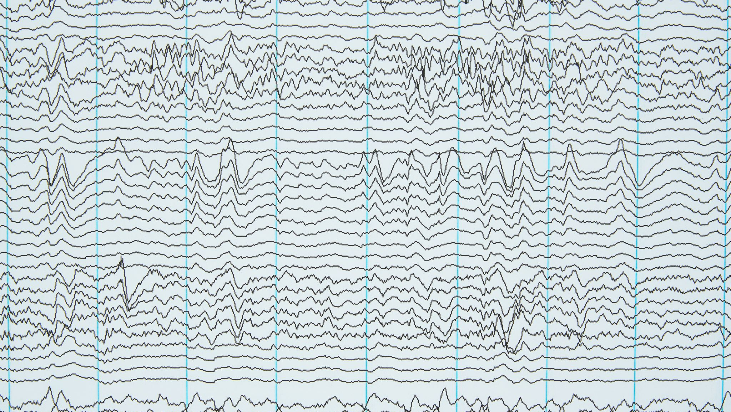
Data Visualization
Visualizations
Histogram of Charges
Box plots for categorical variables
Scatter plot of BMI vs. Charges
Pair plots to visualize relationships between variables

Slide 6
Data Cleaning
Handling Missing Values
Check for missing values
Imputation strategies
Outlier Detection and Treatment
Identification using statistical methods
Treatment

Slide 7

Feature Engineering
Creating New Features
Interaction terms
Polynomial features
Encoding Categorical Variables
One-hot encoding for nominal variables
Label encoding for ordinal variables

Slide 8

Model Building
Algorithms Used
Linear Regression
Decision Tree Regression
Random Forest Regression
Gradient Boosting Machines
Support Vector Regression
Model Training
Train-test split
Cross-validation

Slide 9

Model Evaluation
Metrics
Mean Absolute Error
Mean Squared Error
Root Mean Squared Error
R-squared
Results
Compare performance across different models
Highlight the best-performing model

Slide 10

Model Interpretation
Feature Importance
Analysis of feature importance for tree-based models
Coefficients for linear models
SHAP Values
Explain individual predictions

Slide 11

Conclusions
Summary
Key findings from the analysis
Best predictive model
Business Implications
How insights can be used to make informed decisions in the insurance industry
Future Work
Potential improvements
Other data sources and features to consider

